Slide 1
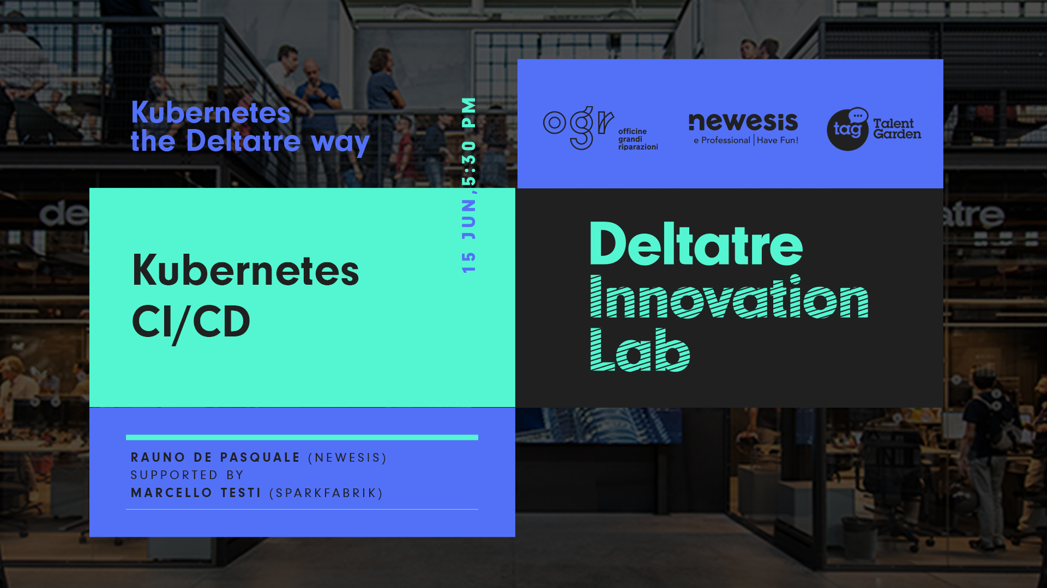

Slide 2


About us
Linkedin: https://www.linkedin.com/in/rauno-de-pasquale-b075773
Twitter: @RaunoDepa
Rauno De Pasquale, Co-Founder and CTO at Newesis Srl, constantly trying to reconcile his degree in Philosophy with a passion for computer science. After almost 18 year at Deltatre, at the beginning of 2019 he creates Newesis, with the aim of simplifying the use of the most advanced services of Cloud platforms even in fields other than sports.
Marcello Testi, Professional at SparkFabrik. Agile practitioner. Feeling lucky and old because I have witnessed early net/web adoption (one of my first offices was in a small room with noisy modems and servers). Currently with a young AND mature company, helping customers taking advantage of cloud native solutions.
Linkedin: https://www.linkedin.com/in/mtesti/

Slide 3
Agenda
Knowing the common options to operate the deployment of an application.
Knowing the difference between imperative and declarative commands
Content of today session:
Managing deployments with Kubectl and plain manifest files
Managing deployments with Kustomize and manifest patching
Managing deployments with Helm and templates chart
Managing deployments with Terraform and HCL templates
Integration Demo: GitLab, Google Kubernetes Engine and Helm
This session has the scope of providing the basic skills to be able to define and execute the deployment of an application in a Kubernetes environment.
Speaker: Rauno De Pasquale (Newesis) supported by Marcello Testi (SparkFabrik)
Organised by: #DeltatreLab supported by #Newesis and #SparkFabrik
Powered by: #Deltatre
Hashtags: #DeltatreK8S #Containers #Docker #Kubernetes #meetup #webinar
Notes:
We will try to do some short demo to show the different options, using command line. We will also show a simple demo showing integration between repo, pipeline and helm chart.

Slide 4
What this session is not
How to manage your GIT repository
List and comparison between CI\CD platforms
Deep dive in CI\CD as for example how to integrate automatic testing in CI\CD workflow
How to build the application into Docker Images
Refer to:
Monday 25-May 17:30 --> 19:30 - Kubernetes the Deltatre way: Docker in Action
Managing deployments with Custom Resources and Operators
Wait for:
Monday 22-Jun 17:30 --> 19:30 - Kubernetes the Deltatre way: Kubernetes extensibility: CRD & Operators

Slide 5
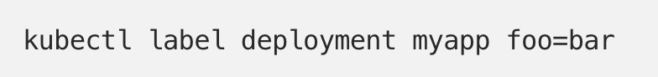
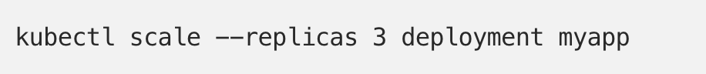
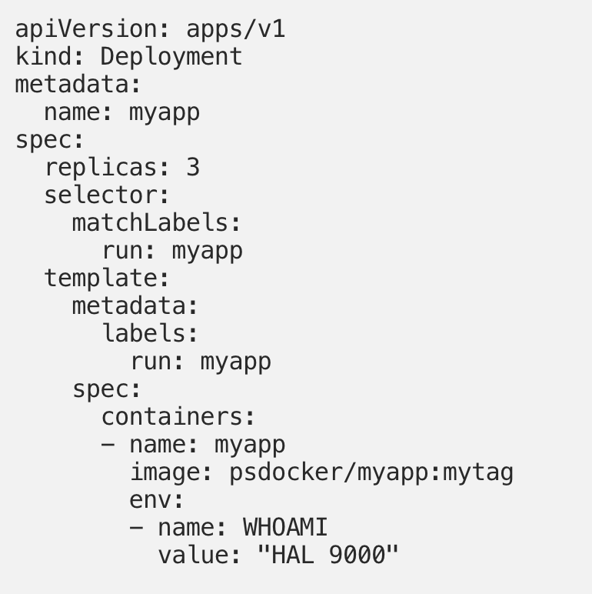
Imperative vs declarative
Imperative
Execute a command
Declarative
Define the desired state
Notes:
You can interact with Kubernetes using both imperative or declarative approach. Manifest files, in yaml format, are used to describe the desired state in the declarative model.
The usage of declarative model is assuring idempotent execution of each command and it is therefore the recommended approach.

Slide 6
Imperative vs Declarative
Demo
Notes:
During this quick demo we show some command to create a name space, create a deployment, assign a label to it, change the version of the image used, scale it. We show how to do the same thing with the two approaches, and we show how the usage of imperative force to know the current status to avoid errors (if you execute a create command for something already existing you get an error), while multiple execution of the same command in declarative manner are not causing any issue. We also try to explain how the usage of declarative approach, due to the usage of yaml files that should be placed on a GIT repo, help to document the desired state and to evolve and version it side by side with the code of the application.

Slide 7
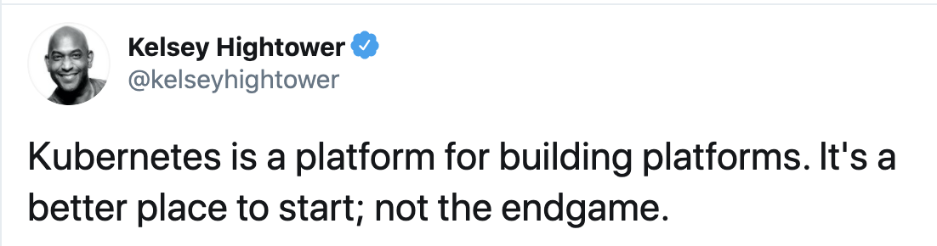
Why ”Kubernetes CI\CD”?
Notes:
Kelsey Hightower is a Staff Developer Advocate at Google, co-chair of KubeCon, the largest Kubernetes conference, and an avid open source technologist, a “sysadmin who can code” from his own description, known also for https://github.com/kelseyhightower/kubernetes-the-hard-way

Slide 8
What composes an application Deployment
POD
Config Map
Service
Volume
Deployment
Secret
Ingress
Storage
Namespace
Cert Manager
Ingress Controller
Storage Class
Limit Quota Policy
Load Balancer
Storage Provider
Public DNS
Notes:
An application is not only composed by a POD where the container is running, but the POD is usually part of a deployment (to manage self-healing and scaling rules). The deployment will live inside a Namespace and the Namespace could have policies applied to it. The deployment could use ConfigMap or Secret, secrets that could be linked with other services as CertManager. To store data the deployment could use volumes, based on storage that has to be statically or dynamically provisioned. Finally a deployment will usually be exposed via a Service, potentially using an Ingress rule to configure an Ingress controller. Many elements need to be configured appropriately and in the correct order, some of the elements could have dependencies out of the responsibility of the application team, as Ingress Controller, Cert Manager and Storage Classes that could have been defined by other groups of people. Some of the objects used are linked with external resources, from other On Premises or Cloud Provider services, as actual storage or load balancer, IPs and DNS.

Slide 9
What makes it even more complex
Different Namespace per feature branch
One replica per deployment
Development Docker Registry
Development
Single Namespace
Multi-replica replica per deployment no auto-scaling
Persistent Storage
Application
Staging
Multi-region setup
Multi-replica per deployment with autoscaling
Production Docker Registry
Production
Notes:
To add complexity, you must consider that you will be running your application in multiple environments and each environment could have its own specific attributes and needs, making the deployment not exactly the same in all situations. We know that ideally, we should always have something coherent and identical cross all environments, but we also know that in real world this is very rarely happening.
Even if you are organising things to have all environment looks the same, you may find you forced to accept differences, for example because of changes on the Cloud Provider used or because of changes caused by new versions of Kubernetes or of third parties controlled elements (as Ingress Controller).

Slide 10
Deployment Tools

Slide 11
KUBECTL and plain manifest
Official Kubernetes Tool
No need to install additional packages
Simple (or better “simpler”)
Standard, you need to know how to use it
Does not directly support variables
Reuse by cloning and editing
You need different manifests
Or you need placeholder and pipelines managing the variables
Does not manage dependencies
You need to manage files and folders orders
Or you need pipelines to be constructed to manage orders of execution
Notes:
The first deployment tool to be considered is the usage of Kubectl with plain manifests. This is a tool you need to know if you work with Kubernetes. You could use this approach to automate delivery using placeholders in YAML files and pipelines to dynamically replace placeholders and to manage the conditions and order of execution. This would make it difficult to try on your machine what the pipeline does (you will have to replace the placeholders and to manually reproduce the order), but, depending on the flexibility of your pipeline engine, you could find no impediment on using this approach also with very complex deployments.

Slide 12
Kubectl Demo
Notes:
During the demo we will not be using a pipeline but we’ll execute the deployment from the command line. We will use the same example for all tools, with the creation of a namespace, settings default limits and quotas to the namespace and creating a Mongodb replicaset deployment.
During this demo we’ll also show the need to order the execution of the files correctly to avoid errors.

Slide 13
Kustomize and json patch
Official Kubernetes Tool
No need to install additional packages
Support variables, patching and composition
Reuse by common “modules”
Easier to segment “ownership” and centrally manage common elements
Easier to manage changes between environments or deployments by changing only snippets with variation
Deployment is done via Kubectl
You need to manage files and folders orders
Or you need pipelines to be constructed to manage orders of execution
Notes:
Kustomize allow to build manifests from templates. This allows for example to reuse the same templates and apply different values or even different attributes based on the environment used. It also allows to delegate specific function, for example the support team managed a specific annotation used by the observability tool, this can be a snipped managed by them and applied to all deployments assuring the same value is applied everywhere cross the entire organisation.

Slide 14
Kustomize Demo
Notes:
Because we already used our default namespace name in the previous demo, we will now use Kustomize to change the namespace used for the Mongodb deployment; we will also add a specific label.

Slide 15
Helm and chart templates
Not part of Kubernetes
You need to install a specific tool
Natively support variables
But it does not support patching
Support for conditional file or portion of file selection
But it does not support composition
Natively support dependencies
Concept of “packages” of application and versioning of the package and not only of individual elements
Notes:
Helm can: Install software; Automatically install software dependencies; Upgrade software; Configure software deployments; Fetch software packages from repositories.
Helm provides this functionality through the following components:
A command line tool, helm, which provides the user interface to all Helm functionality.
Before version 3.0, a companion server component, tiller, that runs on your Kubernetes cluster, listens for commands from helm, and handles the configuration and deployment of software releases on the cluster

Slide 16
Helm Demo
Notes:
We’ll show how our previously used manifests are transformed to become a Helm Chart. We will use the value to define a third name space and how we will not have to care about the order of execution of the single elements.

Slide 17
Terraform and hcl
Same HCL syntax you use for other Terraform resources
Natively managing dependencies
Natively support variables
Integration with Terraform Validate, Plan and Apply workflow
Two possible options:
Direct resource deployment (Kubernetes Provider)
Helm support (Helm provider)
Notes:
Terraform is probably the most popular Infrastructure as Code tool. It has a provider for Helm, meaning you can use Terraform to release Helm Charts providing values using HCL template (or combining values from a file with values declared in the HCL template). Terraform has also a Kubernetes provider to manage directly from Terraform the resources in the cluster.
The usage of Terraform can be an advantage if you are already familiar with HCL syntax and you are using Terraform for the provisioning of other resources.
The ability to execute a plan and verify which actions would be taken if the command would be applied before actually applying it can help on the revision of resources.
The usage of variables, outputs and modules could be very powerful to manage a fully integrated deployment managing in a unified way the resources inside and outside the Kubernetes cluster.

Slide 18
Terraform Demo
Notes:
We will not demonstrate the Helm provider for Terraform, but we’ll define our usual Mongodb replicaset using the Kubernetes provider and execute the deployment.

Slide 19
Integration with Pipelines Demo
Notes:
With this demo we will show you a sample of integration of repository, pipeline and Helm chart.

Slide 20
So what should I use?
We presented some option, probably the most popular ones, but these are not the only options available
Next session we’ll talk about Custom Resources and Operators as an alternative approach to define and manage your solutions in Kubernetes
Presented solutions are not necessarily alternatives, you can combine them following your specific use cases
Start simple and gradually add complexity
Think about the organisational needs and software lifecycle model
Distributed responsibilities works well with Kustomize
Autonomous teams works well with Helm
Terraform competence centre could prefer to use it also for Kubernetes
Notes:
Other options includes Ansible modules, Ksonnet, Skaffold, Gitkube, Kubi. Metaparticle.
The notes about organisational needs are just high level samples, Kustomize can work perfectly with autonomous teams and Helm can be used in companies with distributed responsibilities

Slide 21
LInks
Kubectl - https://kubernetes.io/docs/reference/kubectl/kubectl/
Kustomize - https://github.com/kubernetes-sigs/kustomize
Kustomize - https://kubectl.docs.kubernetes.io/pages/reference/kustomize.html
Helm - https://helm.sh/docs/
Terraform and Kubernetes - https://www.terraform.io/docs/providers/kubernetes/guides/getting-started.html
Terraform and Helm - https://www.hashicorp.com/blog/using-the-kubernetes-and-helm-providers-with-terraform-0-12/
Helm and Kustomize together - https://medium.com/devops-dudes/helm-is-not-enough-you-also-need-kustomize-82bae896816e
GitOps and Kubernetes - https://itnext.io/continuous-gitops-the-way-to-do-devops-in-kubernetes-896b0ea1d0fb

Slide 22
The end – q&A ?

